Slide 1
ASP.NET
Introduction

Slide 2
By the end of this topic, you will the different parts of
An ASP.NET Web Application

Slide 3


Slide 4
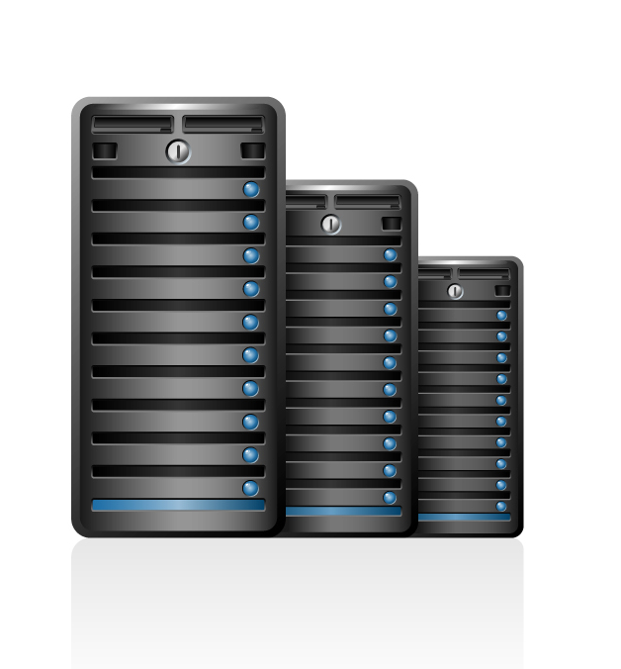
FRONT
BACK

Slide 5
FRONT
BACK

Slide 6
WEB
ASP.NET MVC

Slide 7
WEB
MOBILE
DESKTOP
WATCH
ASP.NET MVC
ASP.NET API

Slide 8
WEB
MOBILE
DESKTOP
WATCH
ASP.NET API

Slide 9
WEB
MOBILE
DESKTOP
WATCH
ASP.NET API
SQL

Slide 10
WEB
MOBILE
DESKTOP
WATCH
ASP.NET API
DATA LAYER
OR
SQL
MySQL

Slide 11
WEB
MOBILE
DESKTOP
WATCH
CACHE
ASP.NET API
DATA LAYER
OR
SQL
MySQL

Slide 12
WEB
MOBILE
DESKTOP
WATCH
CACHE
ASP.NET API
DATA LAYER
OR
SQL
MySQL

Slide 13
WEB
MOBILE
DESKTOP
WATCH
X
WEB APPLICATION FIREWALL
CACHE
ASP.NET API
DATA LAYER
OR
SQL
MySQL

Slide 14
WEB
MOBILE
DESKTOP
WATCH
X
WEB APPLICATION FIREWALL
LOAD BALANCER
CACHE
ASP.NET API
DATA LAYER
OR
SQL
MySQL

Slide 15
API
Application Programming Interface
Glue of the connected world
Set of rules that dictate how clients should interact
Enforces standardized communication between two systems

Slide 16
ASP.NET Core Introduction
0
REST

Slide 17
REST
Representational State Transfer
Style of architecture based on a set of principles
Introduced in 2000 by Roy Fielding
A service that implements the principles of REST is a RESTful service
Ideas
Performance
Scalable
Simple
interoperability

Slide 18
HTTP
Hypertext Transfer Protocol
Used to transport data over the internet
Can be used in other situations
Set of rules
Browser needs to be able to communicate with the server

Slide 19


HTTP == request - response
REQUEST
RESPONSE

Slide 20
HTTP == request - response
URL + VERB
STATUS + MESSAGE
Notes:
De communicatie tussen de host en de client gebeurt via een eenvoudige request/response cycle. De client maakt een HTTP request message aan, stuurt deze naar de host die op zijn beurt een HTTP response message terug naar de client verzendt.

Slide 21
Verbs
GET
Retrieves a resource from the server
Creates a new resource
Modifies an existing resource
Removes a resource from the server
POST
PUT
DELETE
Notes:
Daarnaast bestaan nog andere, minder gekende, verbs.
HEAD: ongeveer hetzelfde als GET maar zonder de message body. Deze wordt meestal gebruikt om te kijken of een resource gewijzigd is zonder de volledige resource te downloaden.
TRACE: wat is de weg die nodig is om een resource op te vragen
OPTIONS: wat zijn de mogelijkheden op de server.

Slide 22
HTTP == request - response
Request
GET http://www.elmos.be/experts/ HTTP/1.1
Host: www.elmos.be
Connection: keep-alive
User-Agent: Mozilla/5.0 (Windows NT 10.0; Win64; x64) AppleWebKit/537.36 (KHTML, like Gecko) Chrome/63.0.3239.132 Safari/537.36
Accept: text/html,application/xhtml+xml,application/xml;q=0.9,image/webp,image/apng,*/*;q=0.8
Accept-Encoding: gzip, deflate
Accept-Language: en-US,en;q=0.9
Cookie: __...

Slide 23
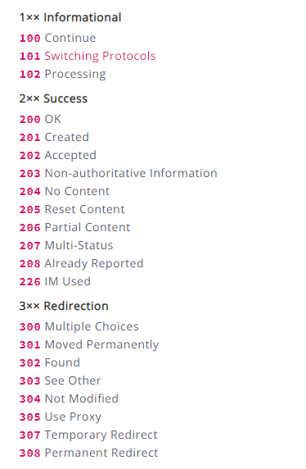
HTTP Status codes
1xx Informational
2xx Success
3xx Redirection
4xx Client Error
5xx Server Error
https://httpstatuses.com/

Slide 24
ASP.NET Core Introduction
1
ASP.NET Core

Slide 25
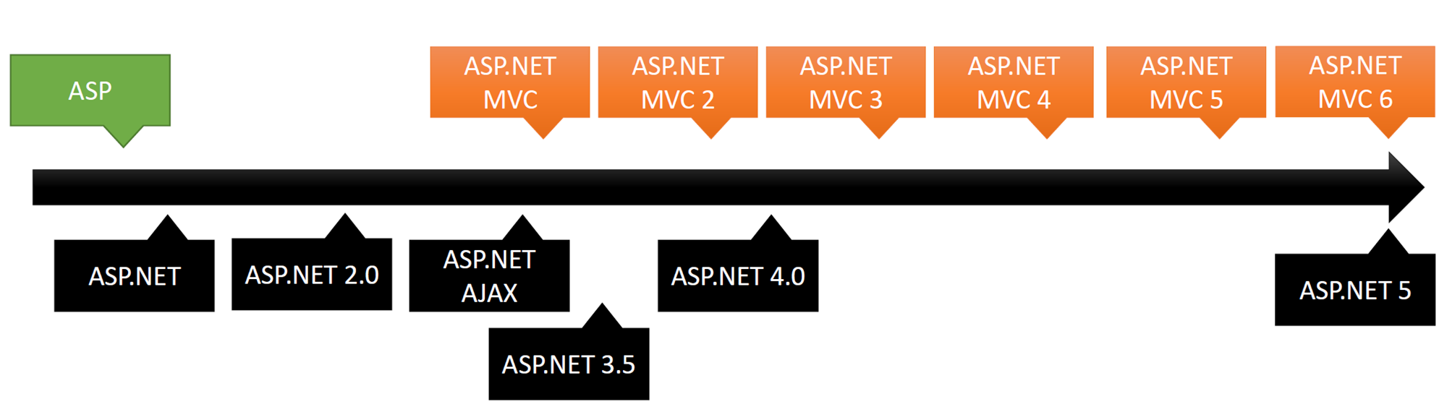

Slide 26
ASP.NET 1
Convert winform developers
into web developers

Slide 27


Slide 28
ASP.NET 3.5
It is getting interesting
Asynchrone requests - AJAX

Slide 29
ASP.NET vs ASP.NET MVC
Suddenly we had MVC, why?

Slide 30

ASP.NET is like driving a safe car. Protects you from everything,
but it comes with a cost

Slide 31


Slide 32

ASP.NET MVC means that you are in control

Slide 33
So, what about ASP.NET core

Slide 34
Disadvantages ASP.NET
If you want to travel fast you only take the necessary items with you
If you take a look at the ASP.NET MVC framework, lots of features are loaded, even when you don’t need them
Logging
Authentication
Databases

Slide 35
From ASP.NET to ASP.NET Core
Microsoft uses an opt-in model
Choose what you need
The only thing you need is something to handle an incoming request
CORE functionality

Slide 36
The big picture
Compilers en runtime componenten
(.NET Compiler Platform: Roslyn, C#, VB, F# languages)

Slide 37
The big picture
.NET Framework libraries
.NET Core libraries
Compilers en runtime componenten
(.NET Compiler Platform: Roslyn, C#, VB, F# languages)

Slide 38
The big picture
.NET Framework 4.6
.NET Core
.NET Framework libraries
.NET Core libraries
Compilers en runtime componenten
(.NET Compiler Platform: Roslyn, C#, VB, F# languages)

Slide 39
The big picture
ASP.NET
ASP.NET Core
.NET Framework 4.6
.NET Core
.NET Framework libraries
.NET Core libraries
Compilers en runtime componenten
(.NET Compiler Platform: Roslyn, C#, VB, F# languages)

Slide 40
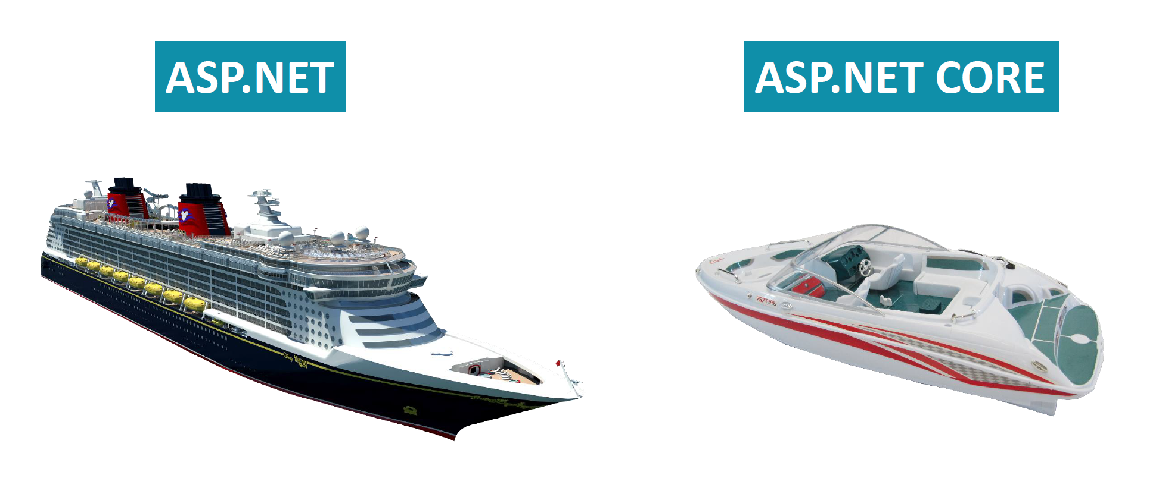

Slide 41
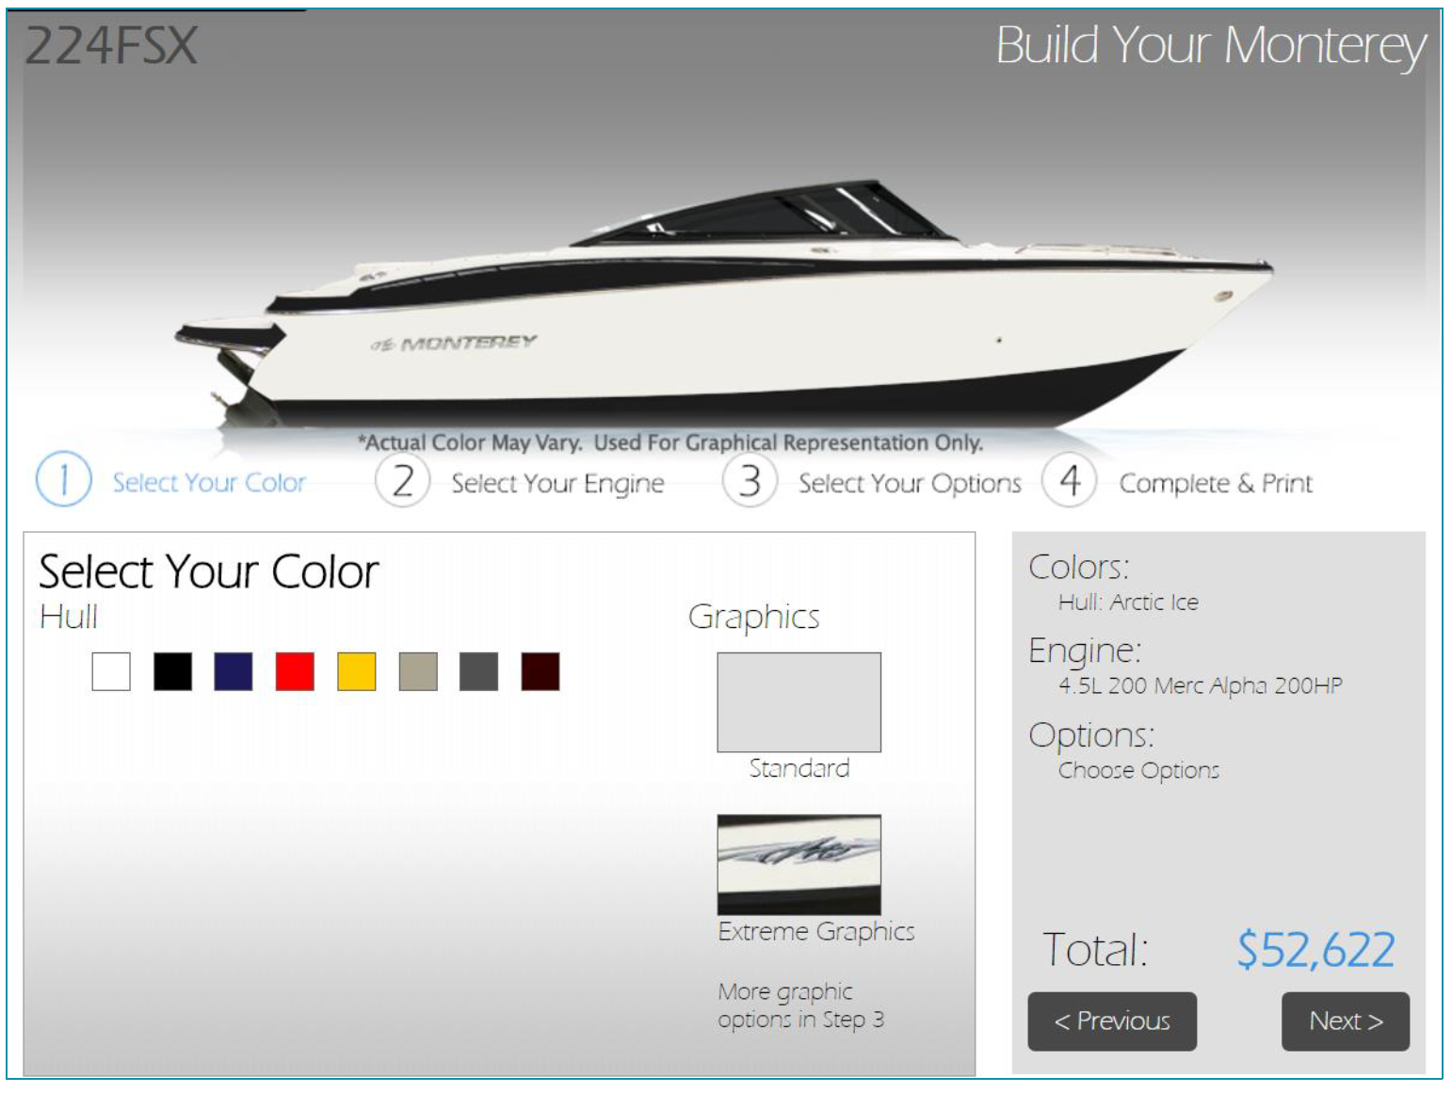
Opt-in model

Slide 42

Opt-in model

Slide 43
Opt-in model

Slide 44
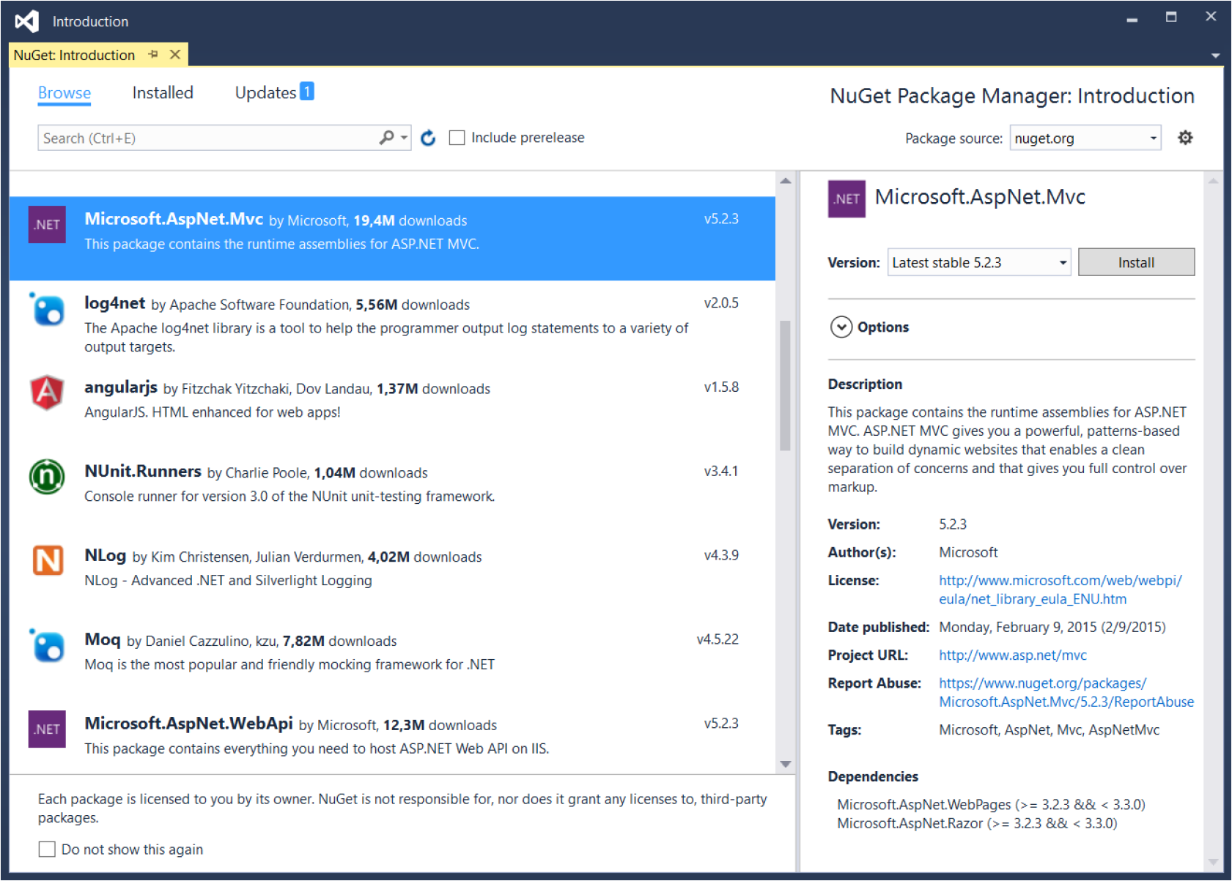
Opt-in model

Slide 45
Other big advantage
Cross Platform
.NET can only be installed on a Windows Machine
.NET core can be installed in multiple platforms
Linux
Apple
Windows

Slide 46
In a nutshell
Optimized through modularity
Can be used for Web Applications or Web APIs
Cross-platform
Open source
Community based

Slide 47
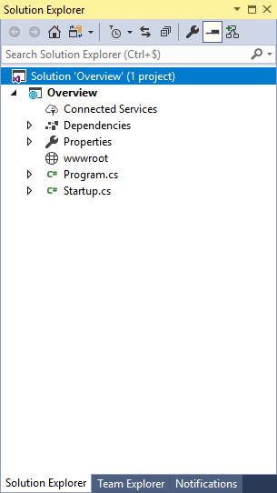
An empty project

Slide 48
ASP.NET Core Introduction
2
Anatomy of an ASP.NET Web Application

Slide 49
WEB FRAMEWORK
WEB SERVER
How do you communicate with a webserver

Slide 50


WEB FRAMEWORK
WEB SERVER
How do you communicate with a webserver

Slide 51
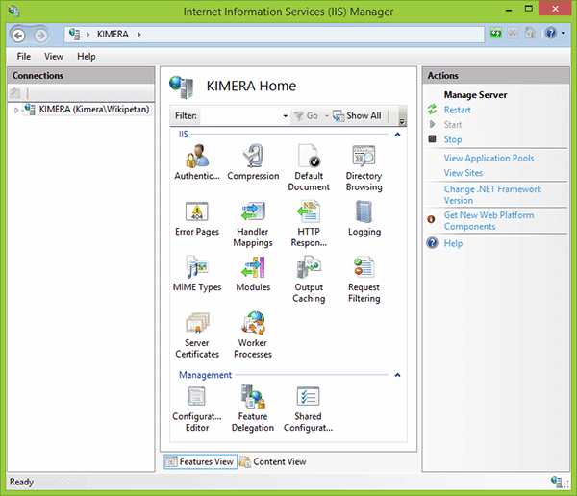

Slide 52
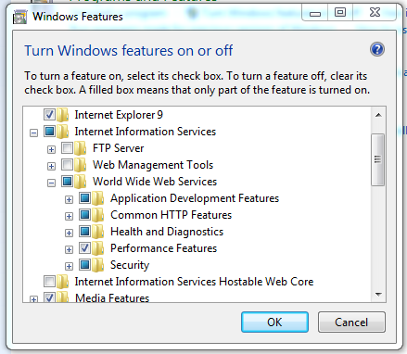

Slide 53

Developers like to decide what their application needs
Developers want a light-weight extensible host for their application

Slide 54
How does it work
Inkomend Request
HTTP handler

Slide 55
How does it work
Behandelt het request
Inkomend Request
HTTP handler

Slide 56
How does it work
Behandelt het request
Inkomend Request
HTTP handler
Uitgaand Request

Slide 57

Concept of web development

Slide 58
How does it work
Before a request is handled, some extra features are needed
Logging
Authentication
Error handling

Slide 59
How does it work
Behandelt het request
Logging
Authenticatie
Error handling
Inkomend Request
HTTP handler
Uitgaand Request

Slide 60
How does it work
Behandelt het request
Middleware
Logging
Authenticatie
Error handling
Inkomend Request
HTTP handler
Uitgaand Request

Slide 61
How does it work
Middleware
Logging
Authenticatie
Error handling
Inkomend Request
HTTP handler
Uitgaand Request

Slide 62
Middleware
Pass through components that form a pipeline between a server and application to inspect, route, or modify request and response messages for a specific purpose

Slide 63
Middleware
Pass through components that form a pipeline between a server and application to inspect, route, or modify request and response messages for a specific purpose

Slide 64
public void Configure(...){
if (env.IsDevelopment()){
app.UseBrowserLink();
app.UseDeveloperExceptionPage();
}
else{
app.UseExceptionHandler("/Error");
}
app.UseStaticFiles();
app.UseMvc();
}

Slide 65
ASP.NET Core Introduction
3
WEB API

Slide 66

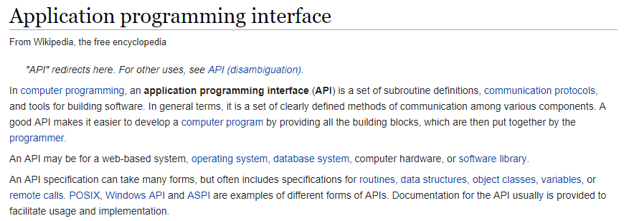

Slide 68
Web API
Interface which has a set of functions to allow programmers access specific features or data of an application or other services
Accessed using HTTP Protocol

Slide 69
ASP.NET Web API
Extensible framework for building HTTP based services
Build RESTful services
Characteristics
Built on top of ASP.NET
Maps HTTP verbs to method names
Supports different formats of response data

Slide 70
MVC vs API
MVC 5x
Razor
HTML Helpers
Controllers
Actions
Filters
Model Binding
Dependency Injection
Routing

Slide 71
MVC vs API
MVC 5x
Web API x
Razor
HTML Helpers
Controllers
Controllers
Actions
Actions
Filters
Filters
Model Binding
Model Binding
Dependency Injection
Dependency Injection
Routing
Routing

Slide 72
What is a RESTful service
Representational State Transfer
Standards between computer systems on the web, making it easier to communicate with each other
Light-weight
Based on a URL + VERBS
Notes:
https://smartbear.com/blog/test-and-monitor/understanding-soap-and-rest-basics/

Slide 73
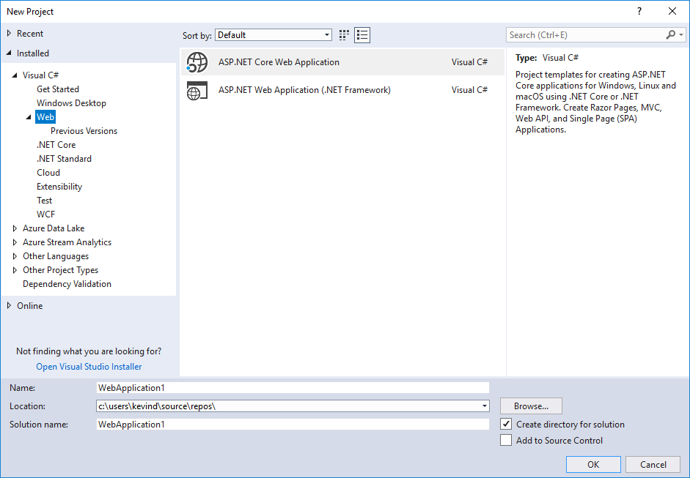
Create your first service

Slide 74
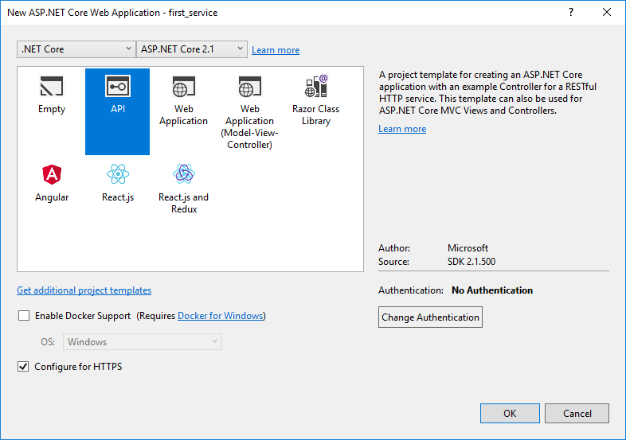
Creating your first service

Slide 75
ASP.NET Core Introduction
3
Project Overview - Startup

Slide 76
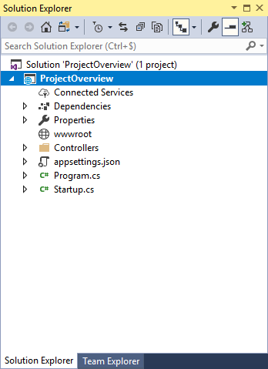
Startup class
Entry point of your ASP.NET application
Cfr. Global.asax in previous version of ASP.NET
Configuration of your application
Which services do you want to use?
Are you going to use localization?
which logging will you provide?
...
Application pipeline configured and defined by
the developer

Slide 77
Startup class
Must define a Configure method
Optionally a ConfigureServices method
called when application is started

Slide 78
Configure
This method tells the application how to respond to HTTP Requests
public void Configure(IApplicationBuilder app, IHostingEnvironment env)
{
if (env.IsDevelopment())
{
app.UseDeveloperExceptionPage();
}
else
{
app.UseHsts();
}
app.UseHttpsRedirection();
app.UseMvc();
}

Slide 79
UseHSTS
HTTP Strict Transport Security
Forces connections over HTTPS
https://docs.microsoft.com/en-us/aspnet/core/security/enforcing-ssl?view=aspnetcore-2.2&tabs=visual-studio
Notes:
Imagine, if you will, that you are at your favorite restaurant or just getting back to your hotel room from that conference and you want to use their free Wi-Fi. Have you ever noticed that their Wi-Fi passwords are printed on paper and never changed?
A malevolent hacker has booked a room at this same hotel. They are eavesdropping on all of the connections going over this insecure, wireless network.
Within the hacker’s sheaf of evil-doings is something called a ‘packet sniffer’. A packet sniffer is network utility that analyses and may inject tasks into the data-stream travelling over the targeted network.
This hacker could capture your network traffic over HTTP for any website that relies on 301 redirects alone for switching from HTTP to HTTPS. This method presents a window of opportunity for the hacker to strip down your SSL encryption and steal valuable data or even worse, present a fake login portal page.
This is why your website must employ HTTP Strict Transport Security over just HTTPS. Obtaining an SSL Certificate will never be enough.

Slide 80
ConfigureServices
Optional
Services used in your application need to be configured
Executed before the configure method
public void ConfigureServices(IServiceCollection services)
{
services.AddMvc();
}

Slide 81
ConfigureServices
Services are made available through dependency injection
ASP.NET Core includes a simple built-in IoC Container
Can be replaced with your favourite container

Slide 82
Application services
ASP.NET core provides services and objects during startup
IApplicationBuilder
Builds the request pipeline
IHostingEnvironment
Provides EnvironmentName, ContentRootPath, ...
ILoggerFactory
IServiceCollection

Slide 83
Best practices
Keep your ConfigureServices method clean and readable
public void ConfigureServices(IServiceCollection services)
{
services.AddCors(options => {
options.AddPolicy("CorsPolicy", builder => {
builder.AllowAnyOrigin()
.AllowAnyMethod()
.AllowAnyHeader()
.AllowCredentials();
});
});
}
BAD

Slide 84
Best practices
Keep your ConfigureServices method clean and readable
Tip: use Extension Methods
GOOD
public void ConfigureServices(IServiceCollection services)
{
services.ConfigureCors();
}
Notes:
https://code-maze.com/aspnetcore-webapi-best-practices/

Slide 85
ASP.NET Core Introduction
4
Project Overview – Project Structure

Slide 86
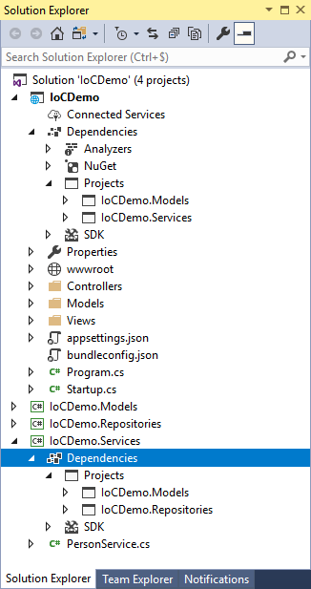
Project Structure
Create Projects
Separation of Concerns (SoC)
Different .NET Core Class Libraries
Create folders per project

Slide 87
ASP.NET Core Introduction
5
Configuration

Slide 88
Configuration
Configuration: collection of key/value pairs
Connectionstring, appsettings, ...
In previous versions of ASP.NET, configuration rules where set in the web.config
system.configuration
In this version of ASP.NET, settings can be retrieved from different options
ini files
json files
XML files

Slide 89
public class Startup
{
public Startup(IConfiguration configuration)
{
Configuration = configuration;
}
public IConfiguration Configuration { get; }

Slide 90
AppSettings
{
"Logging": {
"LogLevel": {
"Default": "Warning"
}
},
"demo": "this is read from the settings file",
"ConnectionStrings": {
"DefaultConnection": "Server=.;"
},
"AllowedHosts": "*"
}

Slide 91
Using settings
public ConfigController(IConfiguration configuration)
{
this._configuration = configuration;
}
// GET: api/Config
[HttpGet]
public string Get()
{
return _configuration["demo"].ToString();
}

Slide 92
Environments
ASP.NET core configures app behavior based on the runtime environment
Using environment variables
ASPNETCORE_ENVIRONMENT
Development
Staging
Production
if (env.IsProduction() || env.IsStaging() || env.IsEnvironment("Staging_2"))

Slide 93
Setting the environment
Environment Variables can be set in
IIS Express
IIS
Server

Slide 94
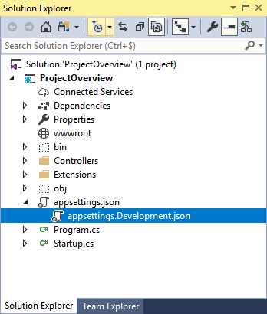
Environment based
While developing you will make a difference between:
Development environment
Production environment
Create a separate configuration file for each
Environment
appsettings.Development
appsettings.Production

Slide 95
ASP.NET Core Introduction
5
A first API application

Slide 96
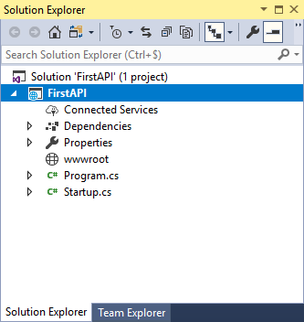
Project-level infrastructure
Nuget Packages
Roslyn analyzers
SDKs

Slide 97
Project-level infrastructure
Nuget Packages
Roslyn analyzers
SDKs

Slide 98
CSProject
<Project Sdk="Microsoft.NET.Sdk.Web">
<PropertyGroup>
<TargetFramework>netcoreapp2.1</TargetFramework>
</PropertyGroup>
<ItemGroup>
<Folder Include="wwwroot\" />
</ItemGroup>
<ItemGroup>
<PackageReference Include="Microsoft.AspNetCore.App" />
<PackageReference Include="Microsoft.AspNetCore.Razor.Design"
Version="2.1.2"
PrivateAssets="All" />
</ItemGroup>
</Project>

Slide 99
Program.cs
public class Program
{
public static void Main(string[] args)
{
CreateWebHostBuilder(args).Build().Run();
}
public static IWebHostBuilder CreateWebHostBuilder(string[] args) =>
WebHost.CreateDefaultBuilder(args).UseStartup<Startup>();
}

Slide 100
Application Startup
UseStartup registers a class that is responsible for configuring the application startup process
The type specified needs to match a specific signature to launch the app correctly
2 public function: ConfigureServices and Configure

